Slide 1
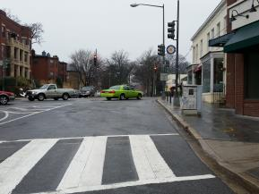
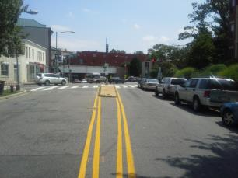
4th Street/Cedar Street/Blair Road Intersection Improvement, NW
Purpose And Need:
Improve safety at congested intersection identified and initiated by Road Safety Audit
Project Scope:
Reconfigure five-legged intersection and upgrade traffic signals
Conversion of 4th Street to a southbound one way street.
Improve pedestrian and bicycle safety
Upgrade street lights on all approaches
Install additional landscaping
Project Status:
Project advertised for construction
Project Schedule:
Project advertised for bids | January 20192018
Notice to Proceed | Summer 2019
Construction Complete | Spring 2020
Project Budget: $2M (Construction)

